Slide 1
Example Schedules for Hosting a College Application Campaign Event

Slide 2
Basic Schedule Ideas from Participating Schools
Utilize a class that all seniors have such as English. During their class period, students visit the computer lab or library to complete college applications.
Group students based on last name and schedule specific hours through the day or week (students will miss different classes based on their personal schedule)
Depending on how large of a student body, you may be able to schedule every senior in one day or it may day a full week.

Slide 3
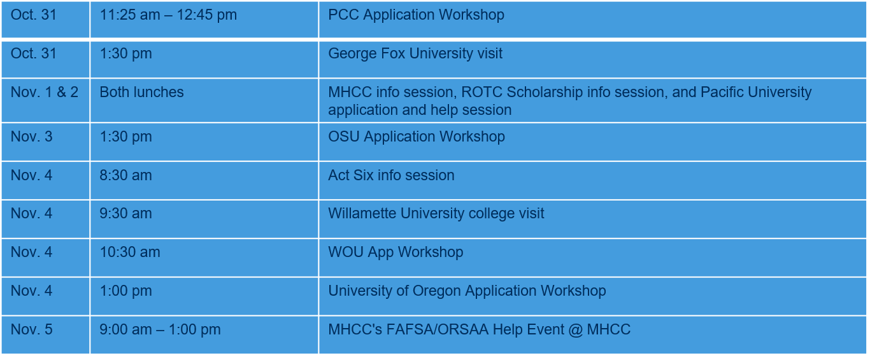
Sam Barlow High School - Schedule

Slide 4
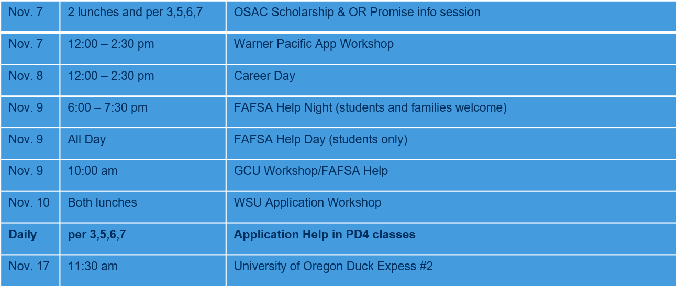
Sam Barlow High School - Schedule

Slide 5
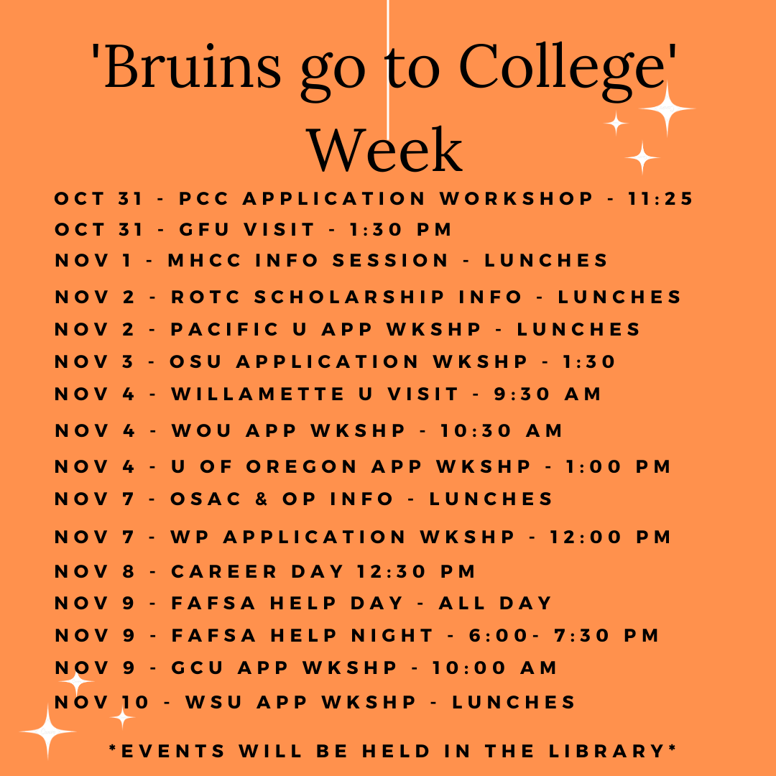
Sam Barlow High School Schedule

Slide 6
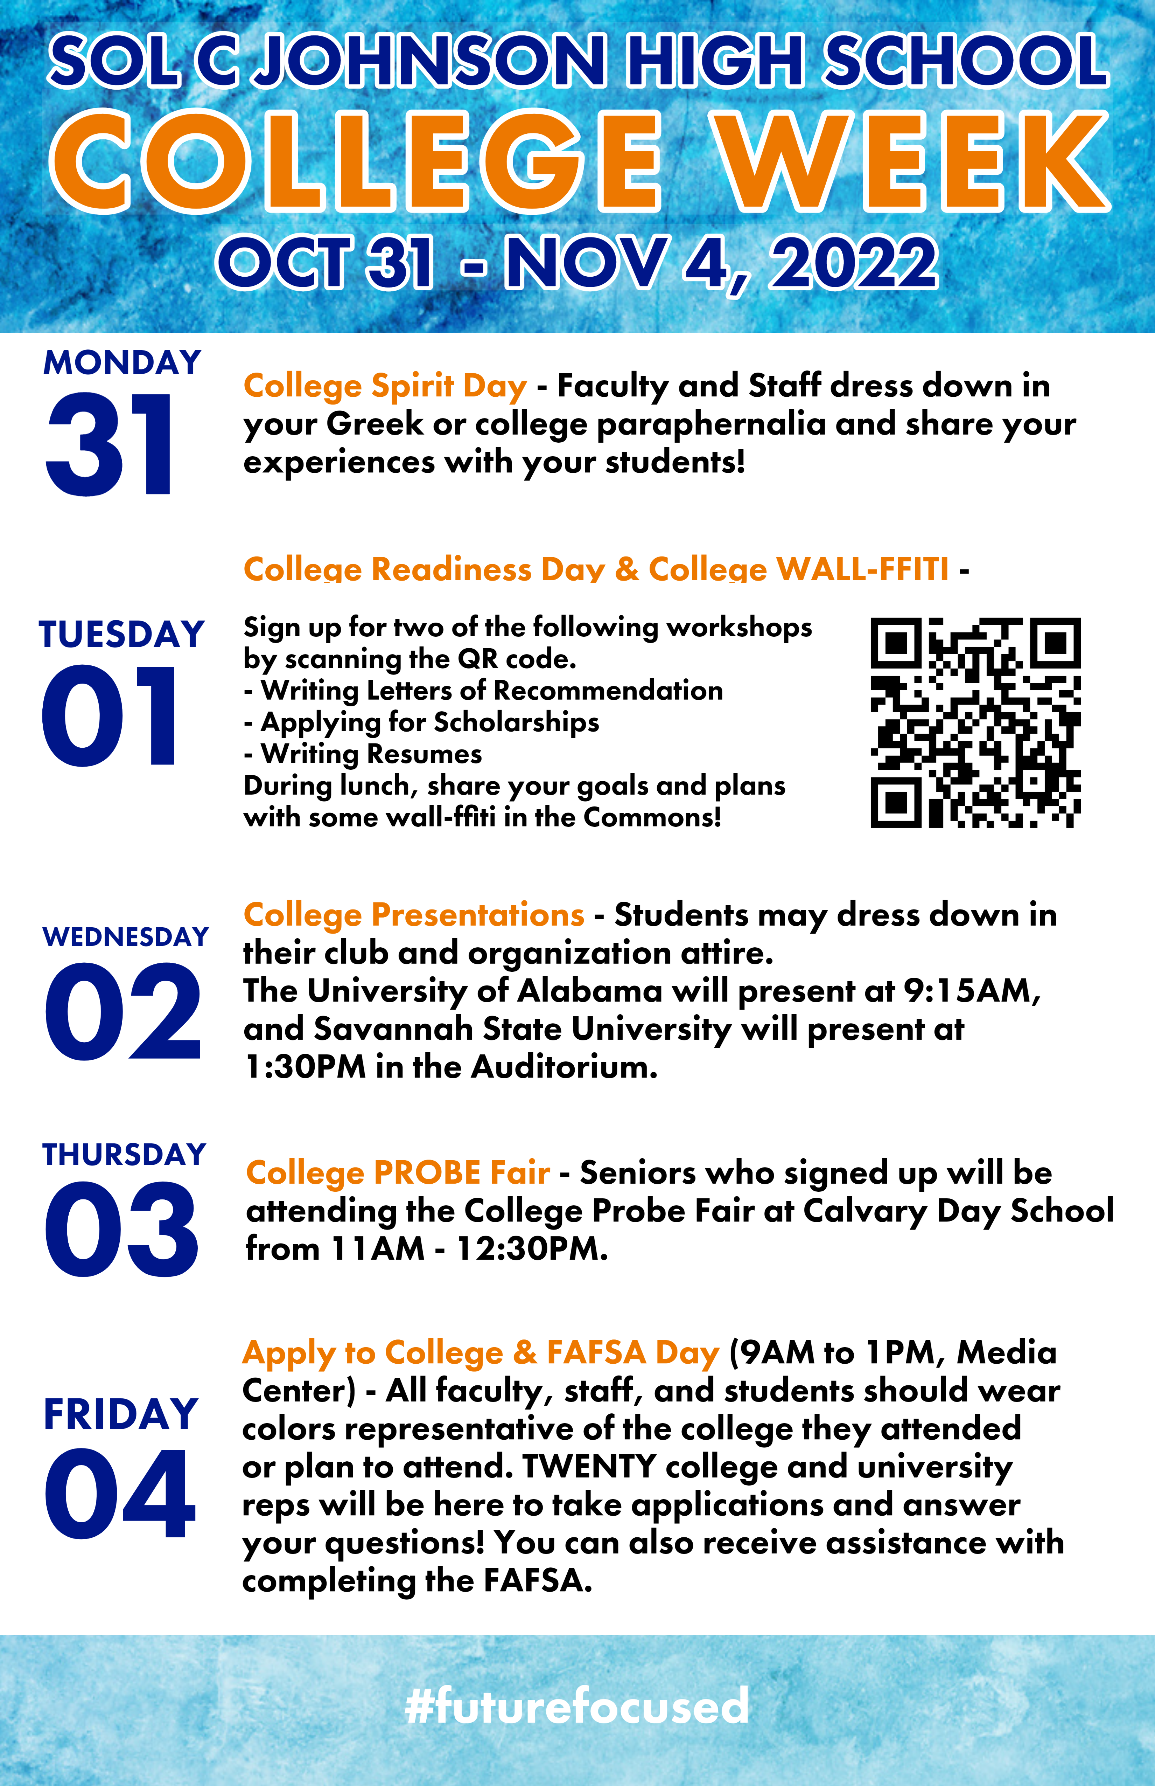
Sol C Johnson High School - Schedule

Slide 7
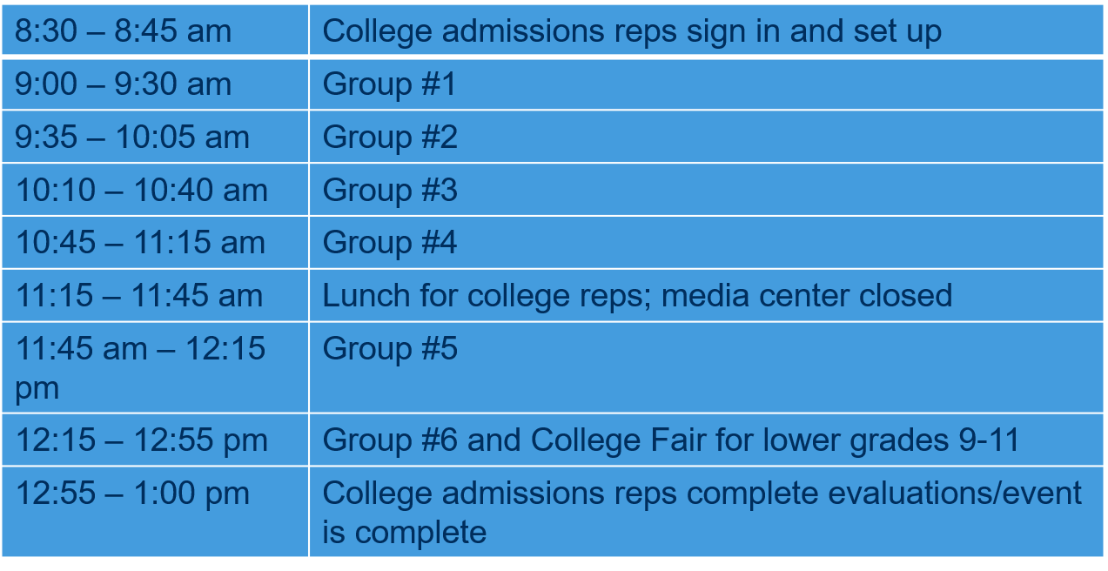
Sol C Johnson High School - Schedule

Slide 8
Stay Connected with the American College Application Campaign
Newsletter: https://impactandlearning.act.org/acac/newsletter/
Facebook: AmericanCAC
X: @American_CAC
Lisa Sommer King Lisa.King@act.org
Trevor McCray Trevor.McCray@act.org

