Slide 1
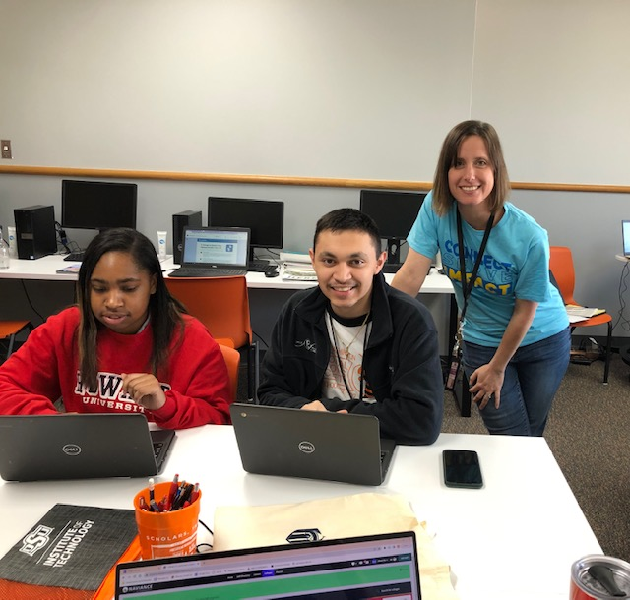
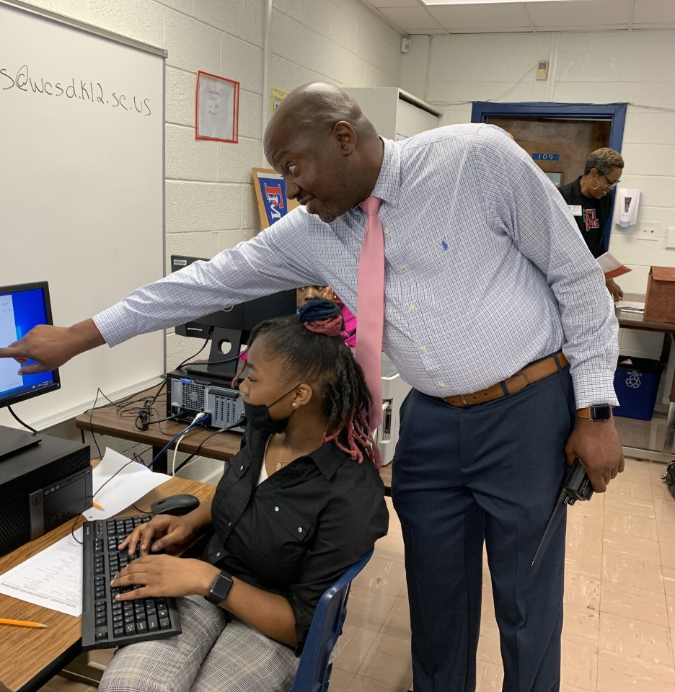
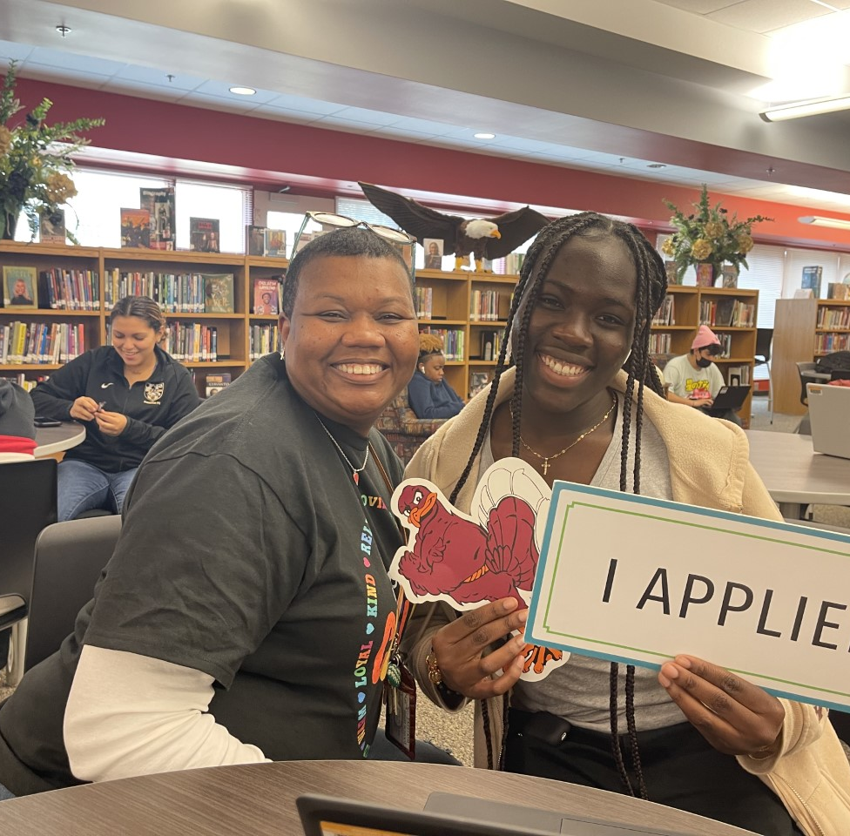
Example Schedules

Slide 2
Sam Barlow HS - Schedule
Oct. 31 | 11:25 am – 12:45 pm | PCC Application Workshop
Oct. 31 | 1:30 pm | George Fox University visit
Nov. 1 & 2 | Both lunches | MHCC info session, ROTC Scholarship info session, and Pacific University application and help session
Nov. 3 | 1:30 pm | OSU Application Workshop
Nov. 4 | 8:30 am | Act Six info session
Nov. 4 | 9:30 am | Willamette University college visit
Nov. 4 | 10:30 am | WOU App Workshop
Nov. 4 | 1:00 pm | University of Oregon Application Workshop
Nov. 5 | 9:00 am – 1:00 pm | MHCC's FAFSA/ORSAA Help Event @ MHCC
Notes:
Lisa

Slide 3
Sam Barlow HS - Schedule
Nov. 7 | 2 lunches and per 3,5,6,7 | OSAC Scholarship & OR Promise info session
Nov. 7 | 12:00 – 2:30 pm | Warner Pacific App Workshop
Nov. 8 | 12:00 – 2:30 pm | Career Day
Nov. 9 | 6:00 – 7:30 pm | FAFSA Help Night (students and families welcome)
Nov. 9 | All Day | FAFSA Help Day (students only)
Nov. 9 | 10:00 am | GCU Workshop/FAFSA Help
Nov. 10 | Both lunches | WSU Application Workshop
Daily | per 3,5,6,7 | Application Help in PD4 classes
Nov. 17 | 11:30 am | University of Oregon Duck Expess #2
Notes:
Lisa

Slide 4
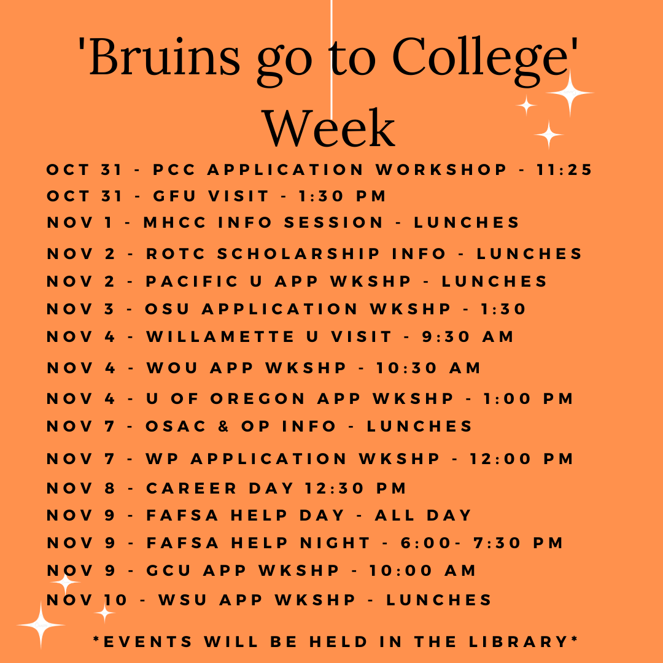
Sam Barlow High School
Notes:
Lisa

Slide 5
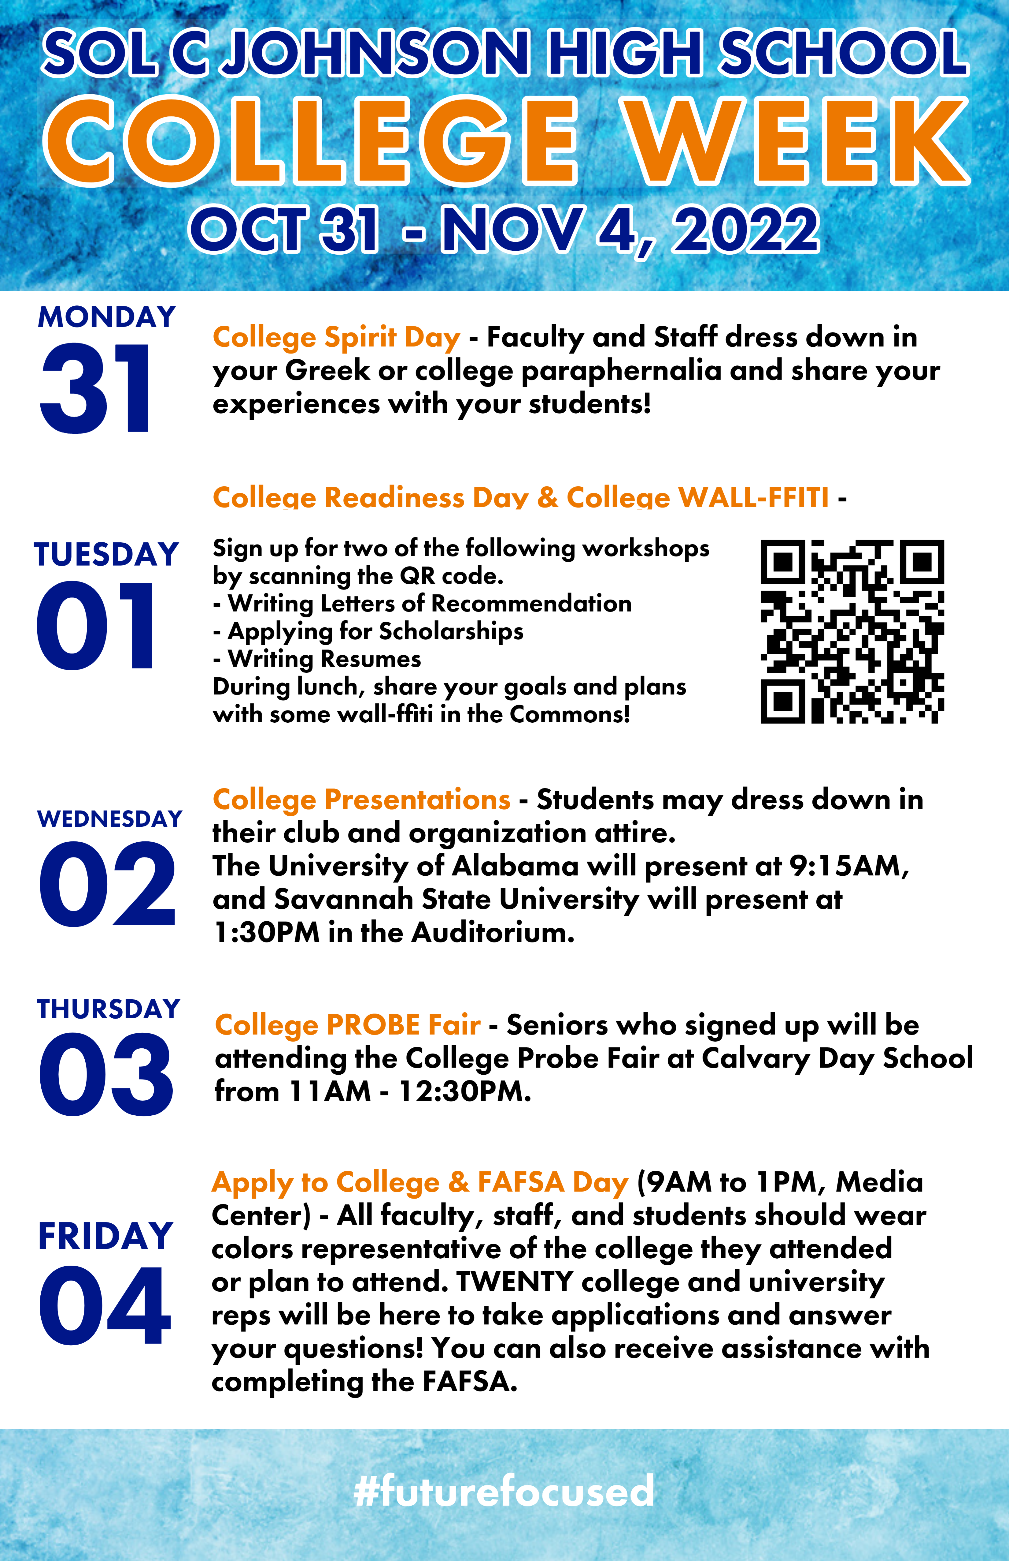
Sol C Johnson High School
Notes:
Lisa

Slide 6
Sol C Johnson - Apply to College & FAFSA Day Schedule
8:30 – 8:45 am | College admissions reps sign in and set up
9:00 – 9:30 am | Group #1
9:35 – 10:05 am | Group #2
10:10 – 10:40 am | Group #3
10:45 – 11:15 am | Group #4
11:15 – 11:45 am | Lunch for college reps; media center closed
11:45 am – 12:15 pm | Group #5
12:15 – 12:55 pm | Group #6 and College Fair for lower grades 9-11
12:55 – 1:00 pm | College admissions reps complete evaluations/event is complete
Notes:
Lisa

Slide 7
Basic Schedule Ideas from Participating Schools
Utilize a class that all seniors have such as English. During their class period, students visit the computer lab or library to complete college applications.
Group students based on last name and schedule specific hours through the day or week (students will miss different classes based on their personal schedule)
Depending on how large of a student body, you may be able to schedule every senior in one day or it may day a full week.
Notes:
Lisa

