Slide 1
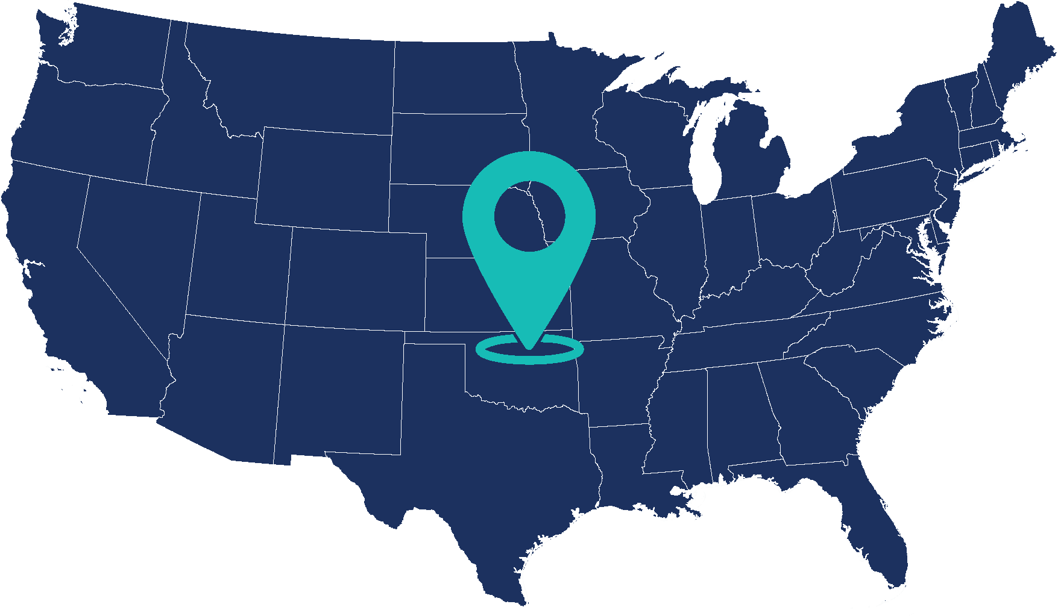
[Name of College or University]
What degrees can I earn?
Certificate or License
Associates or 2 year degree
Bachelors or 4 year degree
Can students live on campus?
Answer
Can I participate in ...
Fraternities or sororities?
Cheering on the big team?
[Location of school X, Y]
This area is:
[Suburb, town, or the country]
Number of students:
Answer
This is a:
[Public or Private School]
Is this a religious college?
[Yes or No]
FUN FACT
Some fun fact about this location will be placed here and should allow for at three lines of text for the longer, more fun facts.

Slide 2


[College or University Logo Goes Here]

